Slide 1
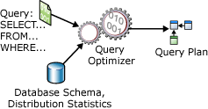
SQL
Module No. 4 | SQL, Query Processing and Optimization
SQL, Steps in Query Processing, Transforming SQL queries to Relational Algebra, Heuristic Query Optimization.

Slide 2
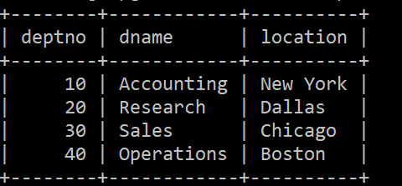
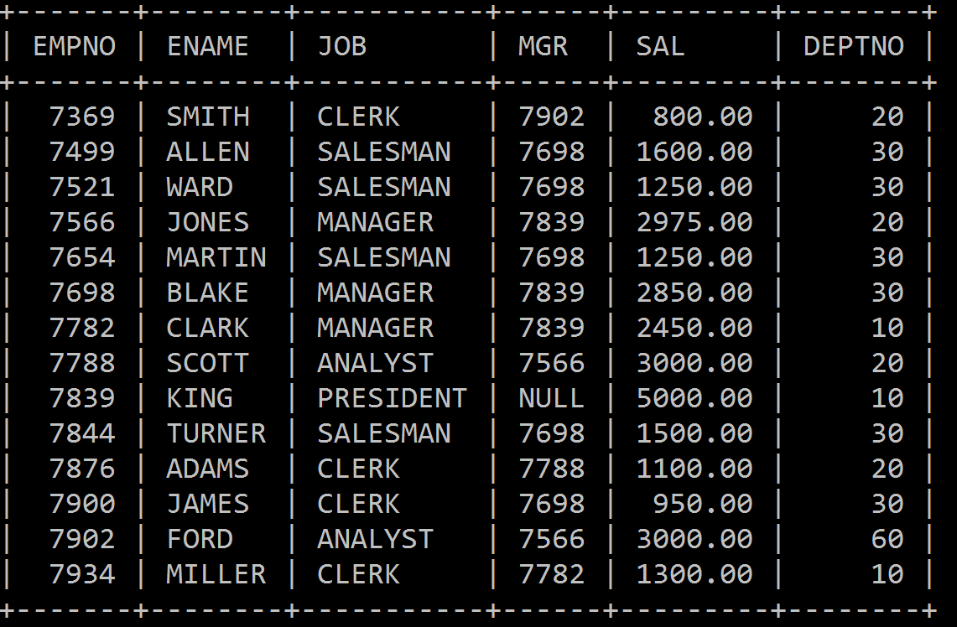
dept
Employee

Slide 3
Display the Employee no, name,salary, Dept no?

Slide 4
Display the Dept no, Dname,Location?

Slide 5
Display the Employee name,Job Dept no, Dname,Location?

Slide 6
What is SQL Joins?
An SQL JOIN clause combines rows from two or more tables.
It creates a set of rows in a temporary table.
How to Join two tables in SQL?
A JOIN works on two or more tables if they have at least one common field and have a relationship between them.
JOIN keeps the base tables (structure and data) unchanged.

Slide 7
Joins
A join enables you to retrieve records from two (or more) logically related tables in a single result set.
JOIN clauses are used to return the rows of two or more queries using two or more tables that shares a meaningful relationship based on a common set of values.
These values are usually the same column name and datatype that appear in both the participating tables being joined.
These columns, or possibly a single column from each table, are called the join key or common key.

Slide 8
About number of join conditions..
Join Keyword is used in SQL queries for joining two or more tables.
Minimum required condition for joining table, is (n-1) where n, is number of tables.
A table can also join to itself known as, Self Join.

Slide 9
Types of SQL Joins
Two types of SQL JOINS - EQUI JOIN and NON EQUI JOIN
1) SQL EQUI JOIN :
The SQL EQUI JOIN is a simple SQL join uses the equal sign(=) as the comparison operator for the condition.
It has two types - SQL Outer join and SQL Inner join.
2) SQL NON EQUI JOIN :
The SQL NON EQUI JOIN is a join uses comparison operator other than the equal sign like >, <, >=, <= with the condition.

Slide 10
SQL EQUI JOIN
The SQL EQUI JOIN can be classified into two types
1. INNER JOIN
2. OUTER JOIN

Slide 11
Types of Equi Join
1. SQL INNER JOIN /Simple Join
This type of EQUI JOIN returns all rows from tables where the key record of one table is equal to the key records of another table.
2. SQL OUTER JOIN
This type of EQUI JOIN returns all rows from one table and only those rows from the secondary table where the joined condition is satisfying i.e. the columns are equal in both tables.

Slide 12
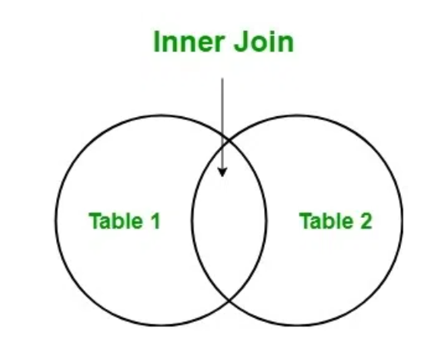
Inner Join syntax
Syntax:
Select Table1.Col_Name, Table2.Col_Name.... From Table1 Inner Join Table2 on Table1.Common_Col = Table2.Common_Col;

Slide 13
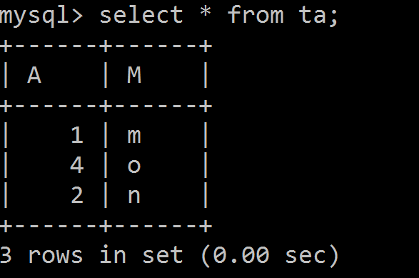
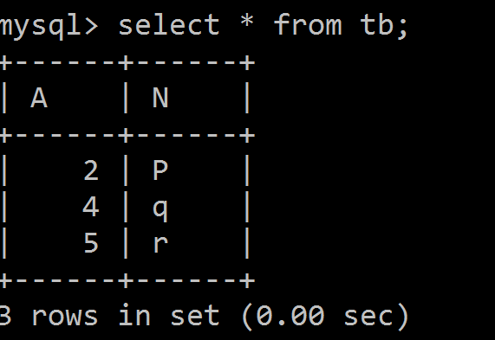
Table A Table B

Slide 14
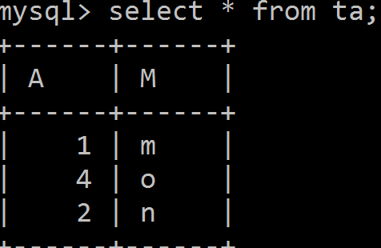
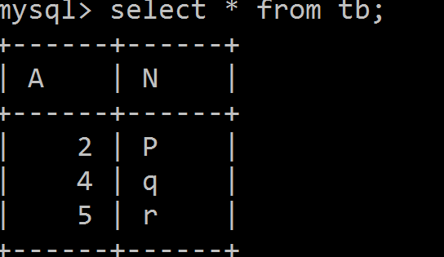
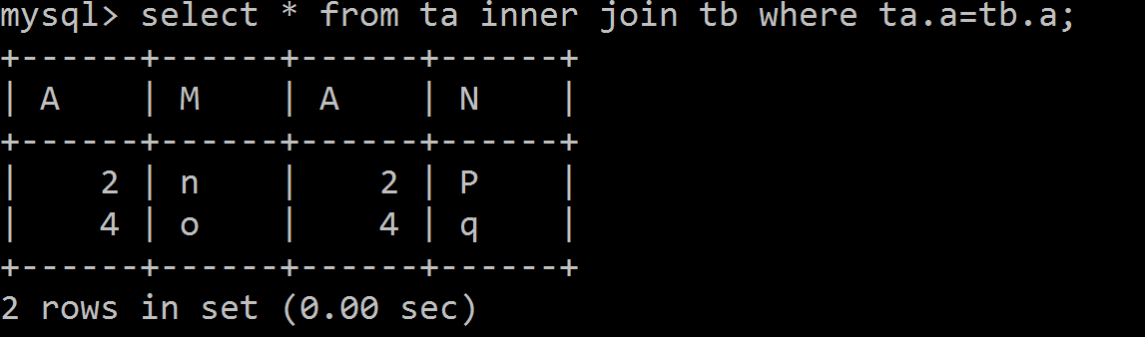
Inner Join

Slide 15
Effective way to use Join Query
select e.e_name as Employee_Name,d.d_name as Department_Name from emp e inner join dept d on e.d_id = d.d_id;

Slide 16
The ON clause and the WHERE clause serve different purposes in SQL, even though both can be used to filter data.
Purpose of the ON Clause
The ON clause is specifically used to define the join condition between two tables.
It specifies how the rows from the two tables should be matched.
It is part of the JOIN syntax and is evaluated during the join operation.
Syntax:
SELECT *
FROM TableA
INNER JOIN TableB ON TableA.id = TableB.id;
Explanation:
Here, the ON clause tells the database to match rows from TableA and TableB where the id values are equal

Slide 17
Purpose of the WHERE Clause
The WHERE clause is used to filter rows after the join operation has been performed.
It applies to the entire result set and is evaluated after the join.
Example:
SELECT * FROM TableA
INNER JOIN TableB ON TableA.id = TableB.id
WHERE TableA.name = ‘Anu';
Here, the WHERE clause filters the result set to include only rows where TableA.name is ’Anu'

Slide 18
Natural JOIN
Natural Join is a type of Inner join which is based on column having same name and same datatype present in both the tables to be joined.
Natural Join Syntax is,
SELECT * from table-name1 NATURAL JOIN table-name2;

Slide 19
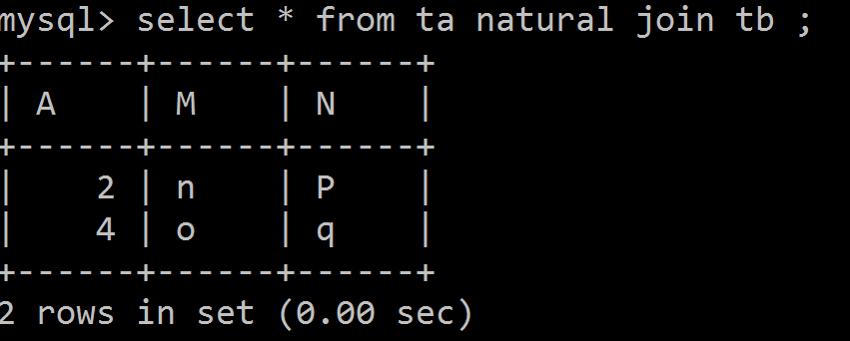

Slide 20
Outer JOIN
Outer Join is based on both matched and unmatched data. Outer Joins subdivide further into,
Left Outer Join or Left Join
Right Outer Join or Right Join
Full Outer Join
Straight Join

Slide 21
Left Join
The left outer join returns a result table with the matched data of two tables then remaining rows of the left table and null for the right table's column.
Left Outer Join syntax is,
SELECT * FROM table_A
LEFT JOIN table_B
ON table_A.A=table_B.A;

Slide 22
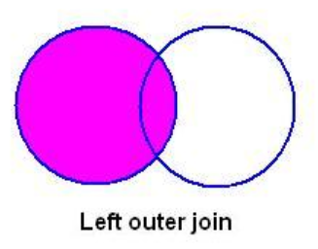
Left Join

Slide 23
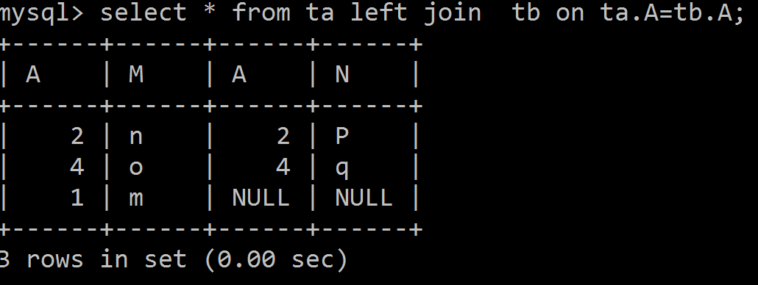
Left Join

Slide 24
Right join
The right outer join returns a result table with the matched data of two tables then remaining rows of the right table and null for the left table's columns.
Right Outer Join Syntax is,
SELECT * FROM table_A
RIGHT JOIN table_B
ON table_A.A=table_B.A;

Slide 25
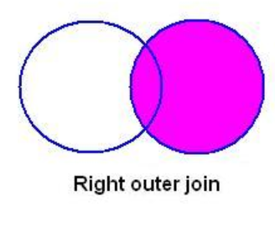
Right Join

Slide 26
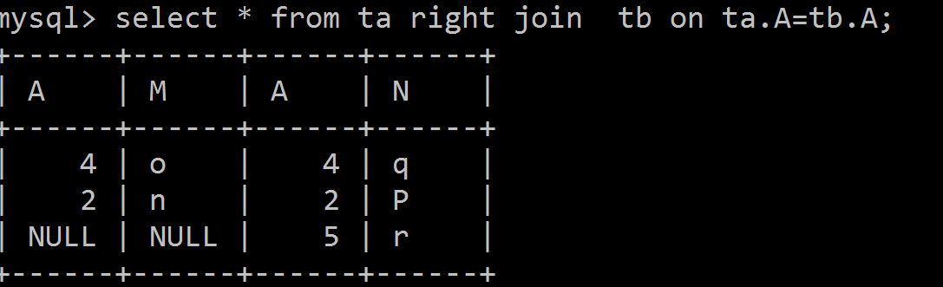
Right Join

Slide 27
MySQL FULL JOIN
A FULL JOIN will combine all rows from both tables and return matching rows where possible. If there’s no match, it will return NULLs for the missing data.
A FULL JOIN (also called a FULL OUTER JOIN) combines the result of both a LEFT JOIN and a RIGHT JOIN. It returns:
All records from the left table, and matching records from the right table.
All records from the right table, and matching records from the left table.
If there is no match, NULL values are returned for the missing side.

Slide 28
MySQL Full JOIN
SELECT *
FROM table1
FULL JOIN table2
ON table1.id = table2.id;

Slide 29
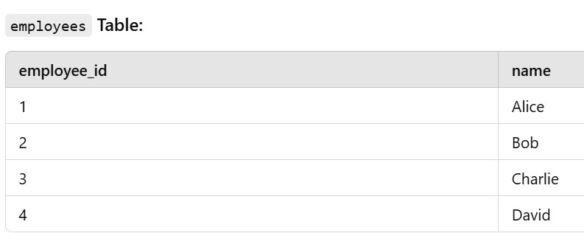
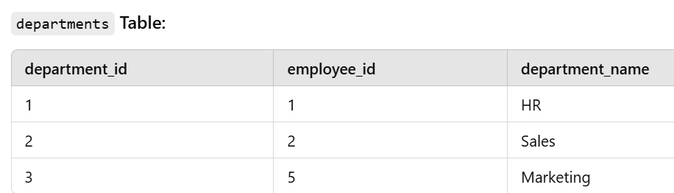
Full Join Example

Slide 30
FULL JOIN Example
SELECT e.employee_id, e.name, d.department_name
FROM employees e
FULL JOIN departments d
ON e.employee_id = d.employee_id;

Slide 31
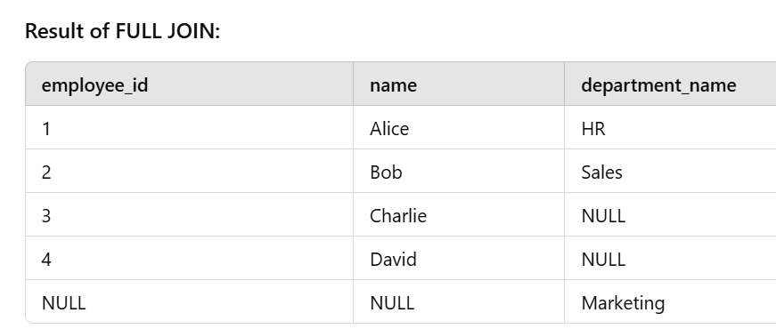
FULL JOIN Example
SELECT e.employee_id, e.name, d.department_name
FROM employees e
FULL JOIN departments d
ON e.employee_id = d.employee_id;

Slide 32
MySQL STRAIGHT JOIN
A STRAIGHT JOIN scans and combines matching rows ( if specified any condition) which are stored in associated tables otherwise it behaves like an INNER JOIN or JOIN of without any condition.
Example : MySQL STRAIGHT JOIN
SELECT * FROM table_A STRAIGHT JOIN table_B;
SELECT *
FROM table1
STRAIGHT JOIN table2
ON table1.id = table2.id;

Slide 33
MySQL STRAIGHT JOIN
A STRAIGHT JOIN will force the SQL engine to process the tables in the order they are written, i.e., the left table (employees) will be processed first, then the right table (departments). STRAIGHT JOIN: Excludes records without a match (similar to an INNER JOIN in this case).
SELECT e.employee_id, e.name, d.department_name
FROM employees e
STRAIGHT JOIN departments d
ON e.employee_id = d.employee_id;

Slide 34
MySQL STRAIGHT JOIN
A STRAIGHT JOIN is a MySQL-specific join that forces the left-to-right order of table processing.
By default, the SQL engine decides which table to scan first for performance reasons (usually based on the table size or indexes). However, with a STRAIGHT JOIN, you are explicitly instructing the database to scan the left table first and then the right table, ignoring any optimization decisions the engine might have.This can sometimes improve performance if the query optimizer does not choose the most efficient strategy, but it's rarely used because most SQL engines handle optimization quite well.

Slide 35
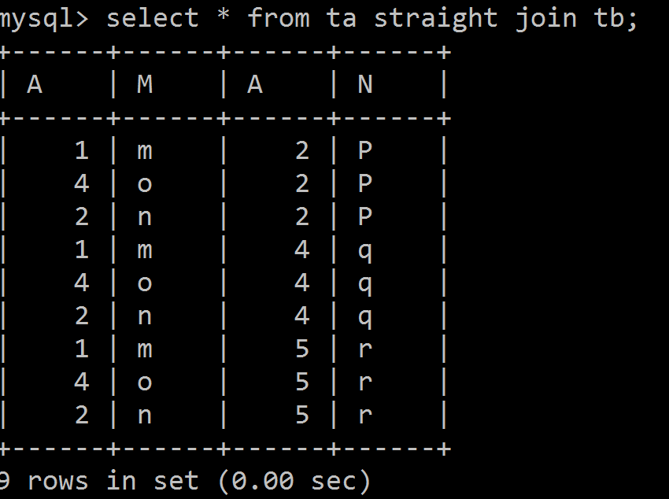
Straight Join

Slide 36
Straight Join

Slide 37
STRAIGHT JOIN Example
SELECT e.employee_id, e.name, d.department_name
FROM employees e
STRAIGHT JOIN departments d
ON e.employee_id = d.employee_id;

Slide 38
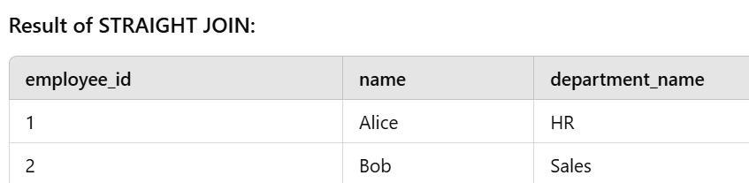
STRAIGHT JOIN Example
SELECT e.employee_id, e.name, d.department_name
FROM employees e
STRAIGHT JOIN departments d
ON e.employee_id = d.employee_id;

Slide 39
CROSS JOIN
★ A CROSS JOIN is the complete cross product of two tables. ★ For each record in the first table, all the records in the second table are joined. ★ Creating a potentially huge result set. ★ This command has the same effect as leaving off the join condition. ★ This result set is also known as a Cartesian product.
Example : MySQL CROSS JOIN
SELECT * FROM table_A CROSS JOIN table_B;

Slide 40
In SQL, a CROSS JOIN (or Cartesian product) combines every row from one table with every row from another, resulting in all possible combinations, while a STRAIGHT_JOIN (MySQL-specific) is similar to a standard INNER JOIN, ensuring the left table is always read before the right.

Slide 41
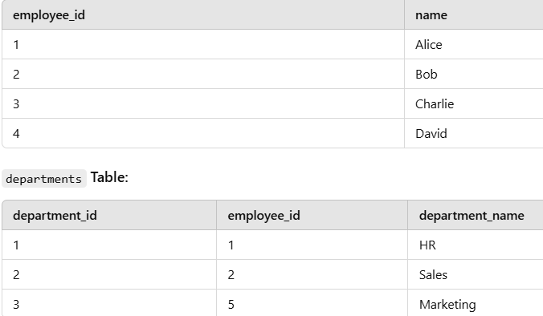
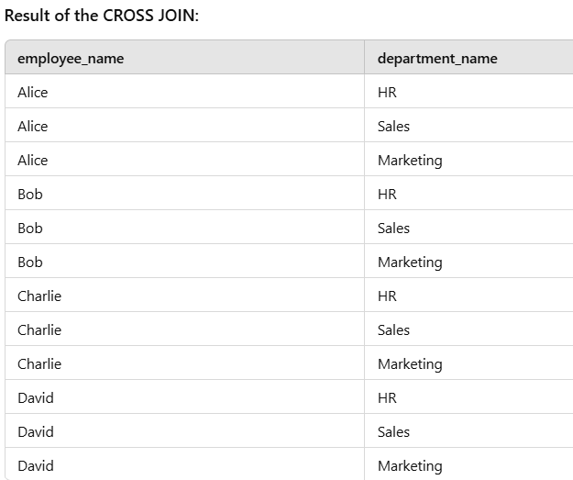

Slide 42
Self Join
A SELF JOIN is another type of join in SQL which is used to join a table to itself, especially when the table has a FOREIGN KEY which references its own PRIMARY KEY.
The self join can be viewed as a join of two copies of the same table. The table is not actually copied, but SQL performs the command as though it were.
In this join, those rows are returned from the table which are satisfying the conditions.

Slide 43
Syntax
SELECT a.column_name, b.column_name... FROM table1 a, table1 b WHERE a.common_field = b.common_field;
select a.e_name,b.e_name from emp a,emp b where a.d_id=b.d_id;

Slide 44
RIGHT JOIN: Returns all records from the right table and matched records from the left table (with NULL if no match).
FULL OUTER JOIN: Returns all records from both tables, with NULL where there is no match. A FULL JOIN returns all rows from both tables, including matching rows and non-matching rows. If there is no match, NULL values are filled in for the missing side.( MySQL does not support)
CROSS JOIN: Returns the Cartesian product of both tables (every row from one table is combined with every row from the other).-Does not require (on clause). The result is m * n rows where m is no of rows in first table and n is no of rows in second table.
SELF JOIN: Joins a table with itself (used for hierarchical data).
NATURAL JOIN: Automatically joins tables on columns with the same name.
Straight Join: s a MySQL-specific join that forces the optimizer to join tables in the order they are specified in the query.
It is similar to INNER JOIN, but the order of tables is fixed, which can be useful for performance optimization in certain cases.

Slide 45
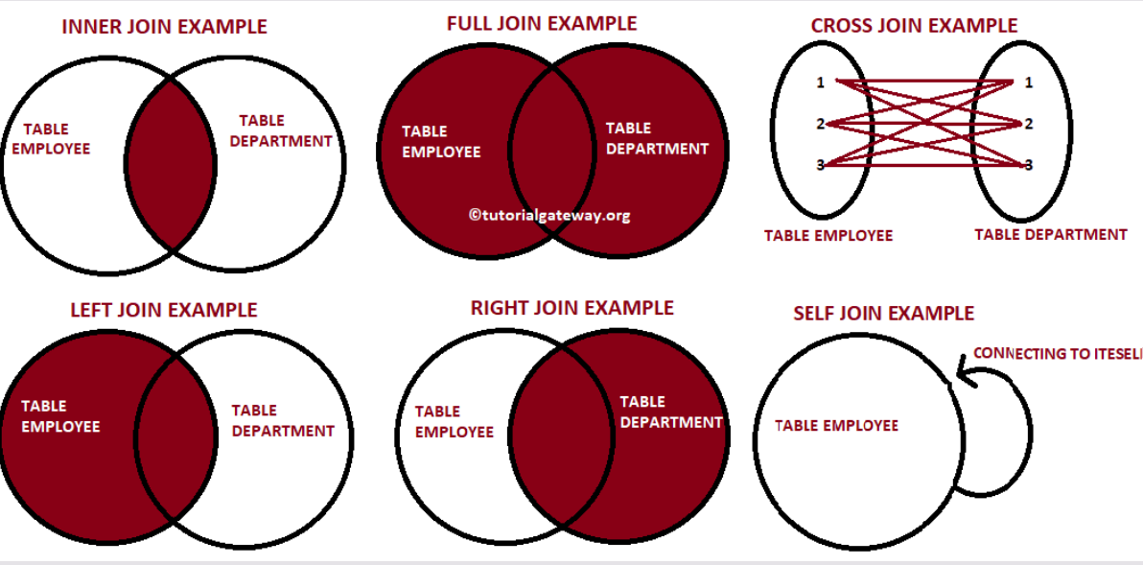

Slide 46
Types of MySQL Joins :
INNER JOIN
LEFT JOIN
RIGHT JOIN
STRAIGHT JOIN
CROSS JOIN
NATURAL JOIN

Slide 47
MySQL INNER JOIN
The INNER JOIN is such a JOIN in which all rows can be selected from both participating tables as long as there is a match between the columns.
Usage of INNER JOIN combines the tables.
An INNER JOIN allows rows from either table to appear in the result if and only if both tables meet the conditions specified in the ON clause.

Slide 48
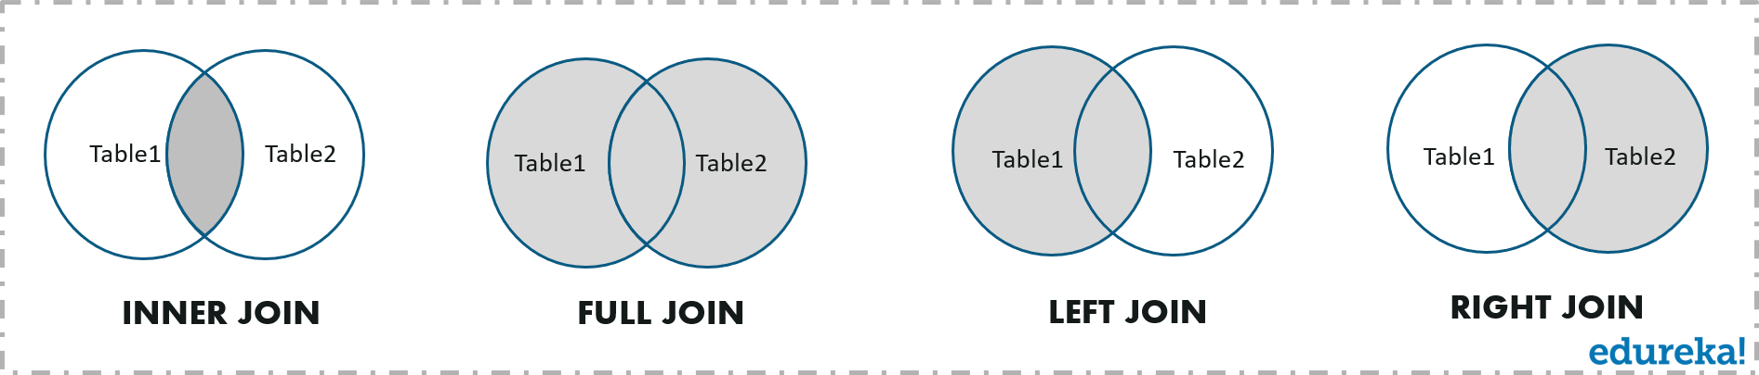
Joins –quick recap

Slide 49
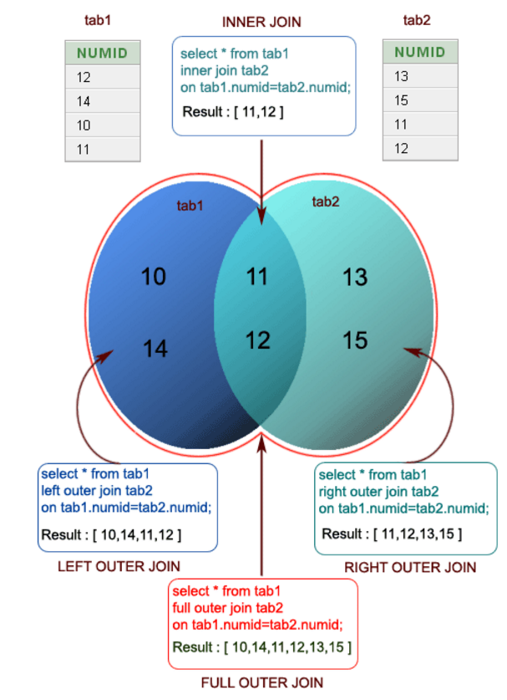
Pictorial Presentation of SQL Joins

Slide 50
Example :Employee DB
Unary relationship to employee
How the employees are related to themselves :
An employee may report to another employee (supervisor).

Slide 51
Find the name of the manager for each employee???

Slide 52
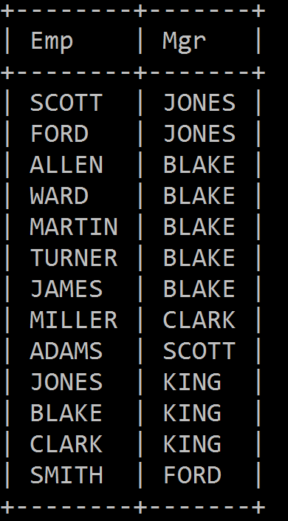
select e.ename "Emp",m.ename "Mgr" from emp e,emp m where e.mgr=m.empno;
Employee Table
Result table

Slide 53
Non-EquiJoin
The SQL NON EQUI JOIN uses comparison operator instead of the equal sign like >, <, >=, <= along with conditions.
SELECT * FROM table_name1, table_name2 WHERE table_name1.column [> | < | >= | <= ] table_name2.column;

Slide 54
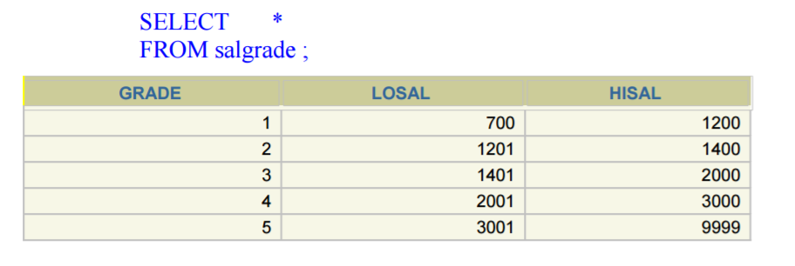

Slide 55
Example
Query:Retreive records where Salary in the EMP table is between low salary and high salary in the SALGRADE table.
SELECT e.ename, e.sal, s.grade FROM EMP e, SALGRADE s WHERE e.sal BETWEEN s.losal AND s.hisal ;

Slide 56
Summary
JOINS allow us to combine data from more than one table into a single result set.
JOINS have better performance compared to sub queries
INNER JOINS only return rows that meet the given criteria.
OUTER JOINS can also return rows where no matches have been found. The unmatched rows are returned with the NULL keyword.
The major JOIN types include Inner, Left Outer, Right Outer, Cross JOINS etc.
The frequently used clause in JOIN operations is "ON". "USING" clause requires that matching columns be of the same name.
JOINS can also be used in other clauses such as GROUP BY, WHERE, SUB QUERIES, AGGREGATE FUNCTIONS etc.

